Slide 1
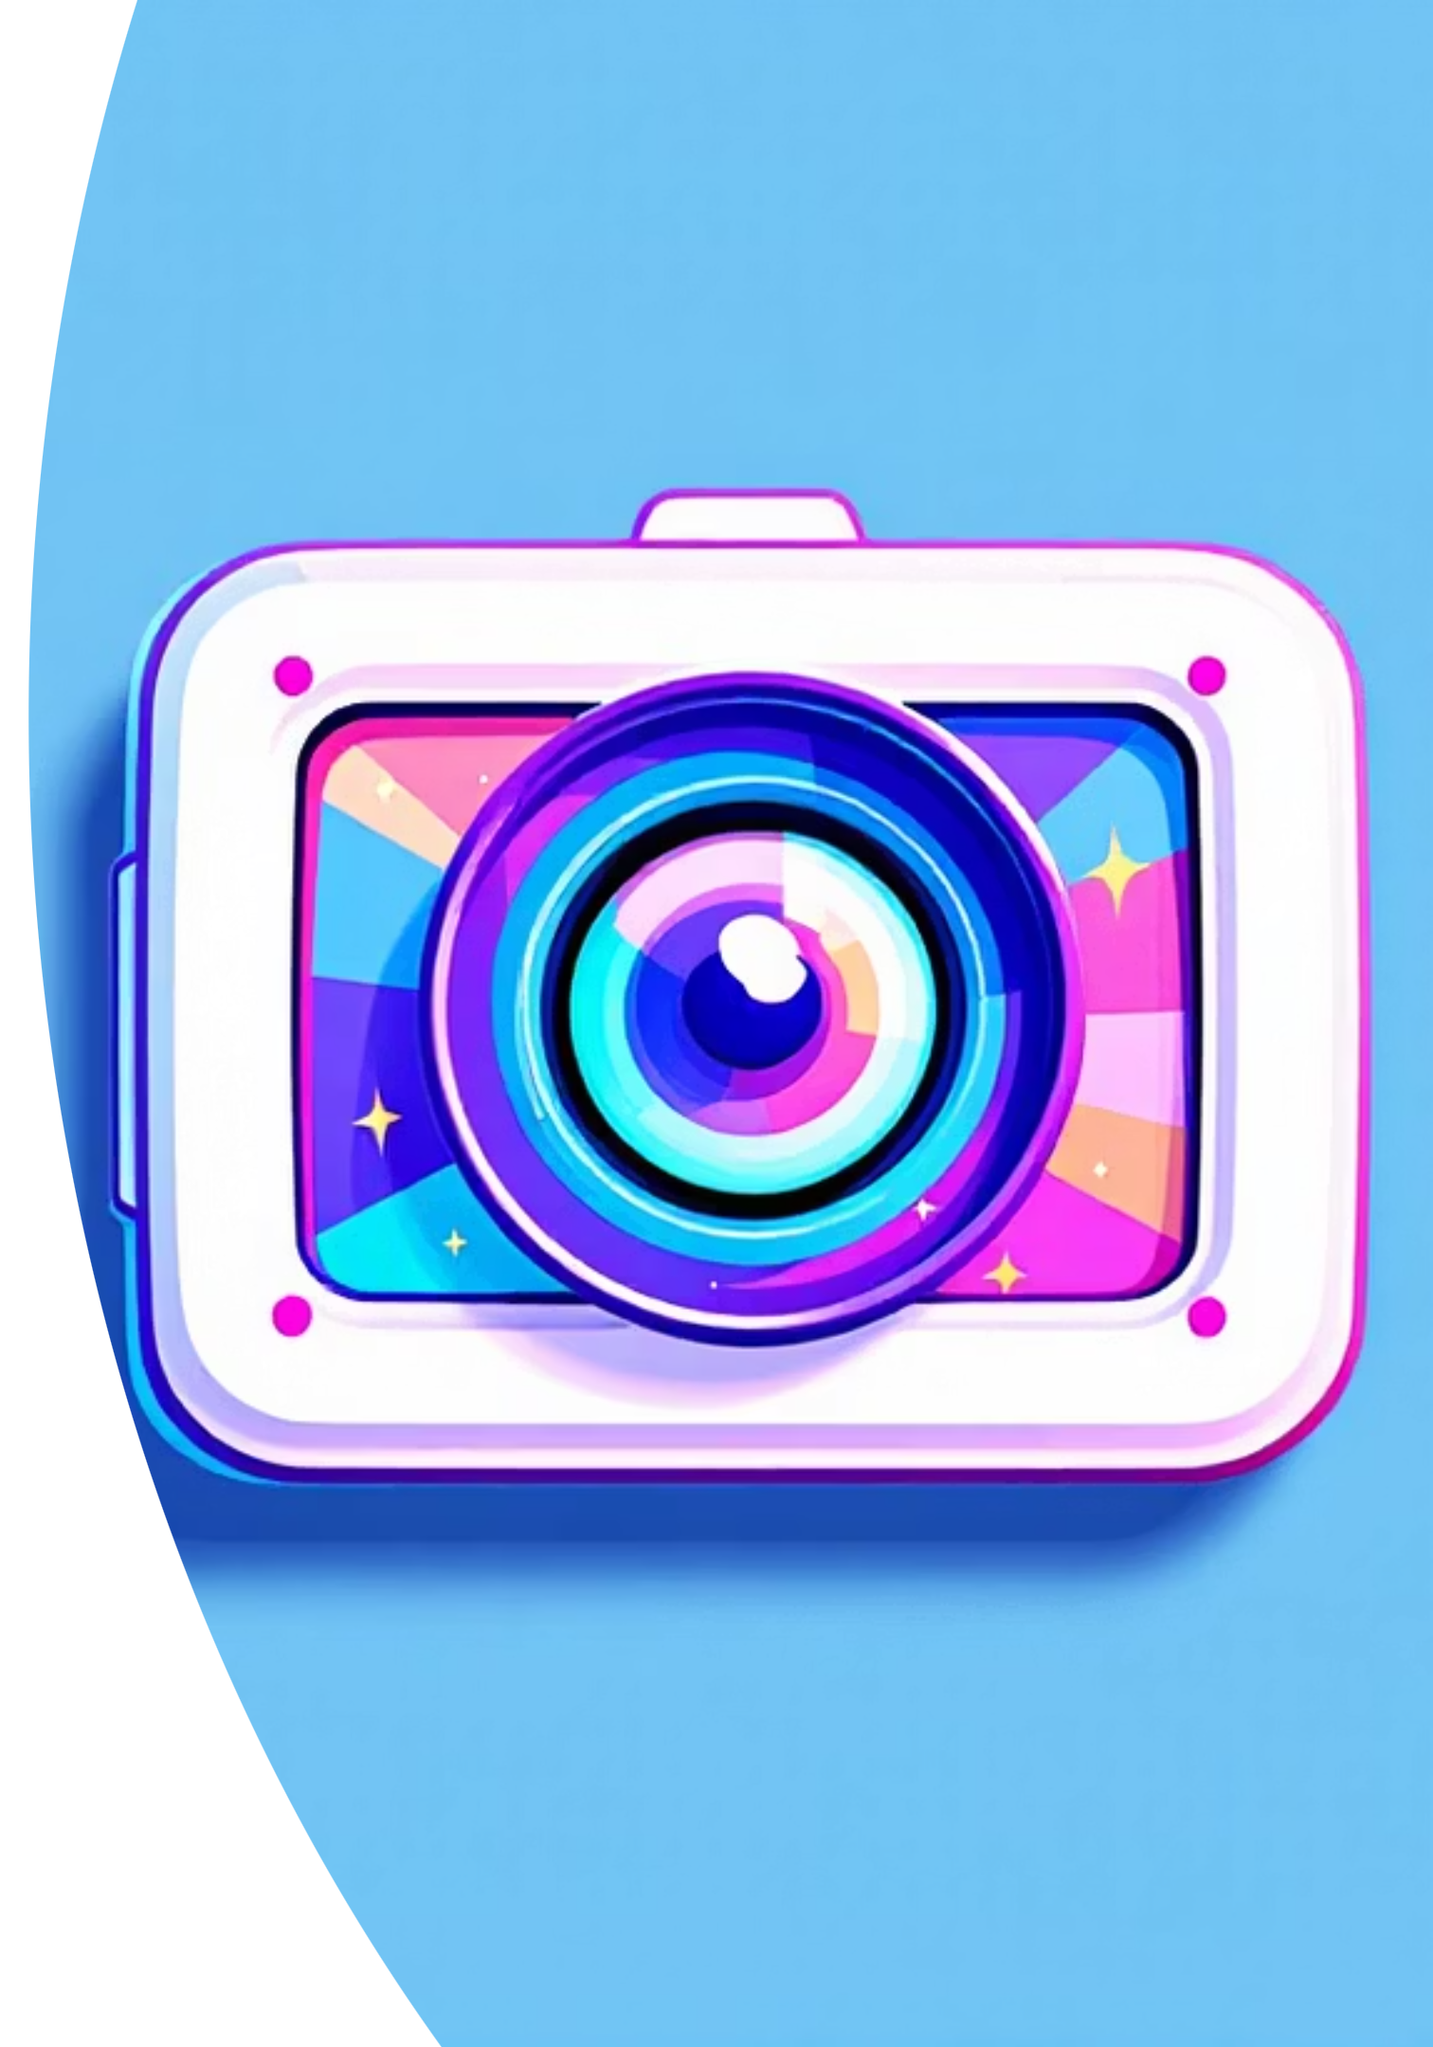
FilterFlow
Real-time Video & Image Processing
Hussein Choueib _ ID: 6500
Ali Al Rida Ezzeddine _ ID: 6419

Slide 2




Agenda
Introduction
Project Flow
Problem Statement
Graphical User Interface (GUI)
Objectives
Performance Comparison
Implemented Filters
Conclusion

Slide 3


Introduction: Project Overview
Sequential Processing
Parallel Processing
Filters applied one step at a time, often leading to slower execution for large files.
Leverages multi-core CPUs to process multiple parts of an image or video concurrently, dramatically reducing processing time.

Slide 4
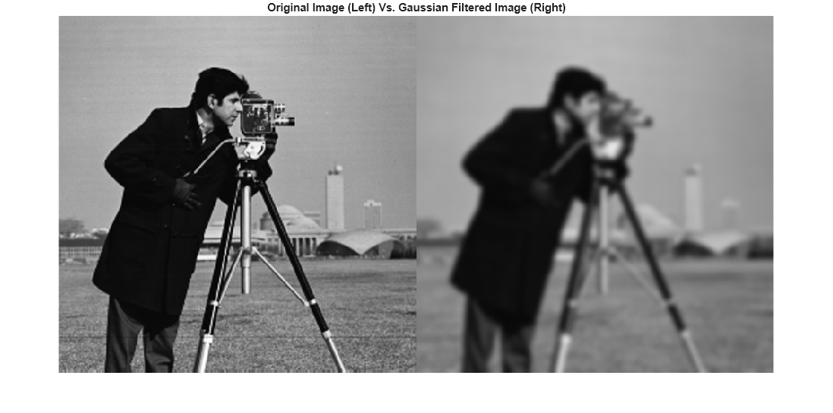
Problem Statement
Traditional image and video filtering techniques are often too slow for real-time or large-scale applications.
There is a need to compare and optimize parallel filtering to improve performance without compromising output quality.

Slide 5


Objectives
Functional
Non-Functional
Gaussian Blur
Performance
With user defined Kernel
≥90% CPU utilization in parallel filtering
x3 times speedup on an 8 core cpu
Sobel Edges
Usability
Detects and highlights image edges.
Intuitive GUI for easy interaction.
Greyscale Filter
Portability
Turns RGB images into greyscale
Containerized via Docker.

Slide 6
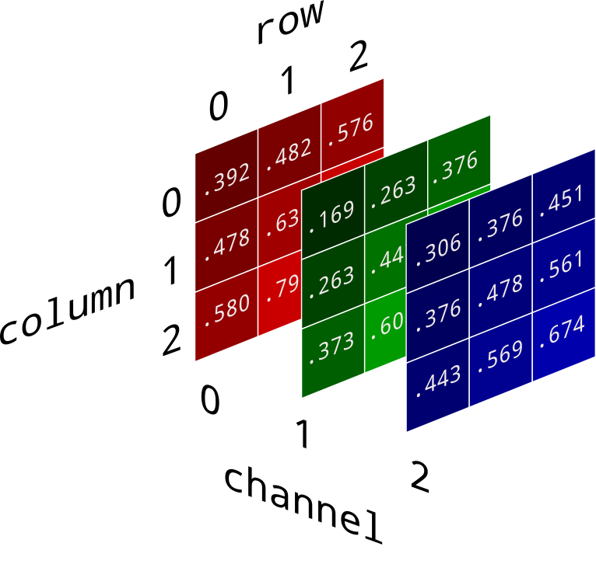
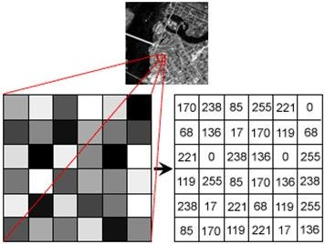
Implemented Filters: Visual Transformations
Grayscale: Converts an image to shades of gray, removing color information.
Gaussian Blur: Blurs an image by applying a Gaussian function, often used for smoothing or reducing detail.
Edge Detection: Identifies significant changes in image intensity, highlighting boundaries of objects.

Slide 7
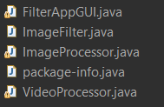
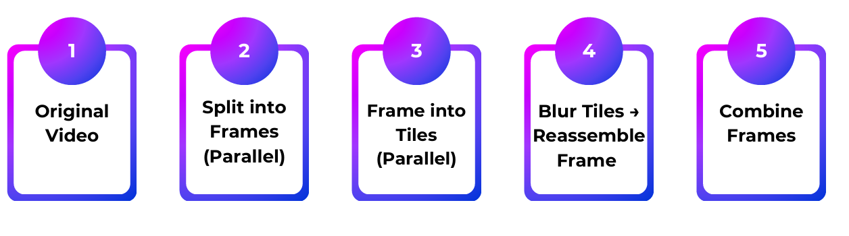
Project Flow

Slide 8
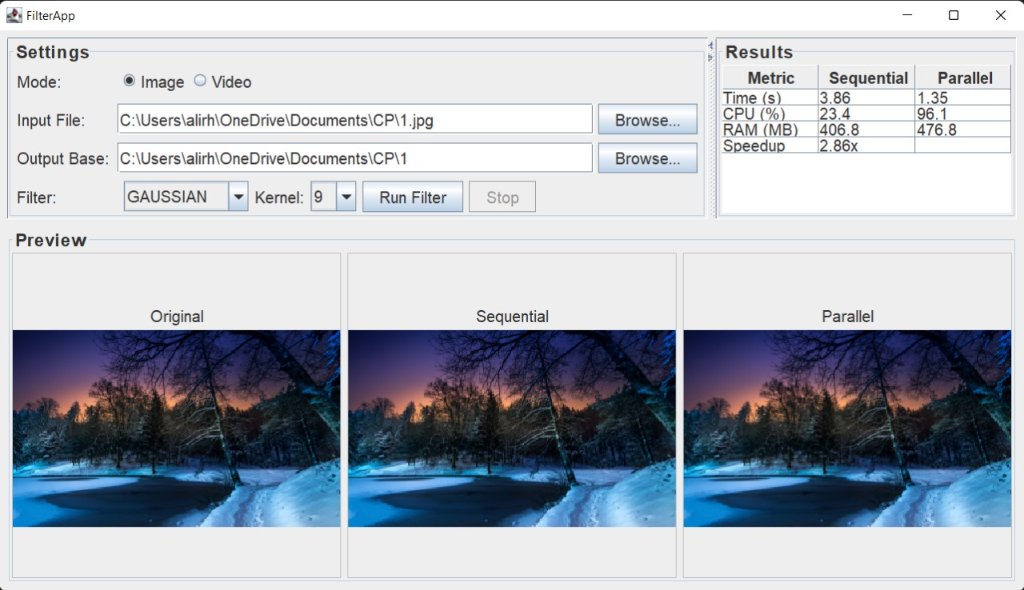
Graphical User Interface (GUI)

Slide 9
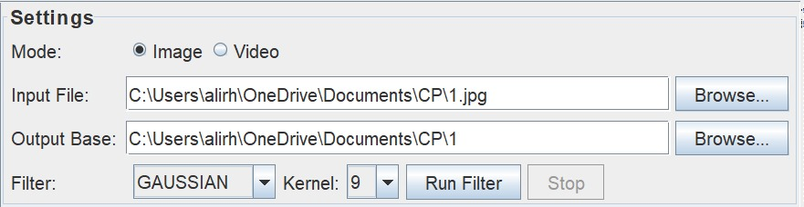
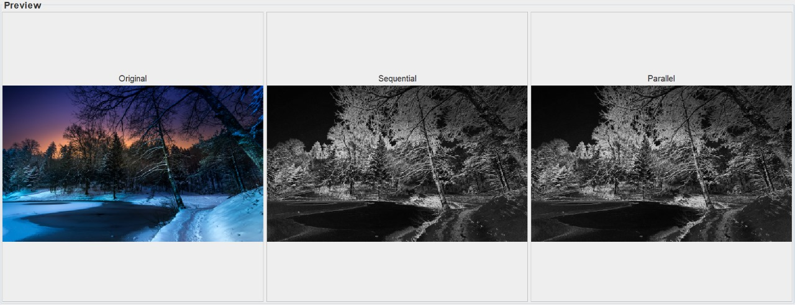
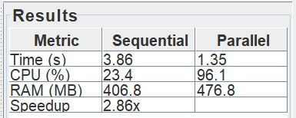
File Selection: Users can load image files (e.g., JPEG, PNG,JPG) or video files (e.g., MP4)
Filter Selection: A dropdown menu or set of buttons for choosing desired filters (Grayscale, Median, Gaussian, Edge Detection).
Preview: Original, Sequential and Parallel
Results : Sequential vs Parallel

Slide 10
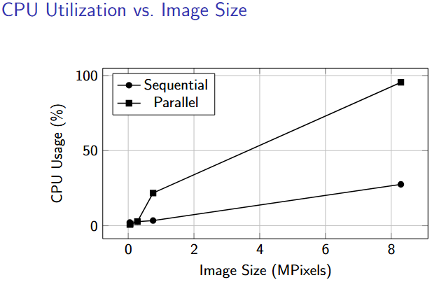
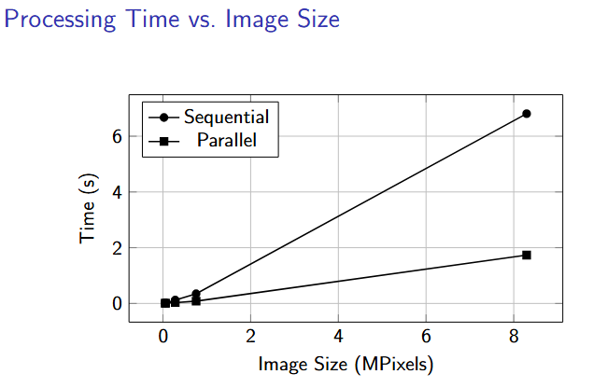
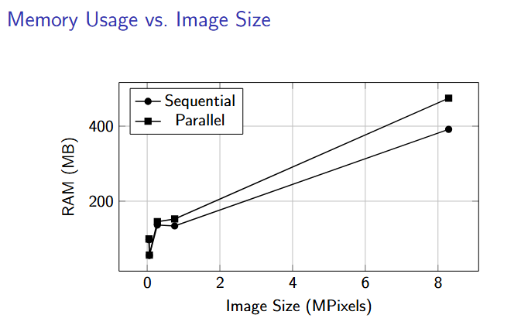

Slide 11
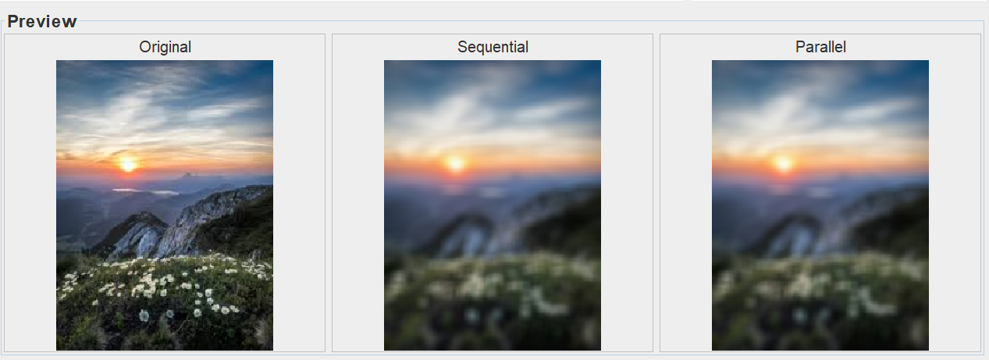
Conclusion
In summary, this project delivers a unified desktop application for both image and video filtering, complete with responsive preview panes that display original, sequential-processed, and parallel-processed outputs side by side. You can toggle between Gaussian, grayscale, and edge-detection filters.Finally, by containerizing the app alongside its hand-managed libraries in Docker (with X11 support for GUI forwarding), you’ve made the entire workflow fully portable and reproducible across any environment.

